Slide 1
Queues and message based architecture

Slide 2
What is a queue?
Infinite loaf of bread
Maybe an infinite bread bin with a finite amount of bread

Slide 3
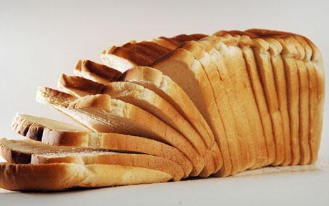
Bread?
Make bread
Eat bread

Slide 4
Oh bread.
Each slice of bread is a slice of data

Slide 5
I don’t have any bread
Okay, so put some other things in the queue
Tasks
Messages

Slide 6
Queue methods
Push/Put/Add
Pop/Get
Peek (not in all queues, try to avoid)

Slide 7
Really easy to make
Typically implemented as a linked list
Depending on access patterns arrays may be more efficient
Can be implemented as a ring buffer

Slide 8
Linked list
0x254A5830
0x864B58CD
0xA64B54FD
0xC0FFE142
Head
Tail

Slide 9
Array
0x254A5830
0x254A5838
0x254A583F
0x254A5848
0x254A584F
Head
Tail

Slide 10
Ring buffer
Head
Tail

Slide 11
Messages
CreateUser
ID
First Name
Last Name
Email Address
Phone Number
….

Slide 12
Serializing messages
0110101011011011001010110110
XML
JSON
Protocol Buffers

Slide 13
In process queues
Let’s look at some code
Things to look out for
Producers
Consumers
Blocking vs. non-blocking queue

Slide 14
To the code!

Slide 15
Out of process queues
There are a million queues out there
MSMQ
RabbitMQ
ZeroMQ
WebSphere MQ
BizTalk (mumble, mumble)

Slide 16
msmq
Let’s look at some code
Things to look out for
Multiple producers
Multiple consumers

Slide 17
Ugh, I hate your powerpoint

Slide 18
Cloud queues
Azure Queues
Amazon Simple Queue Service

Slide 19
I don’t believe you without code

Slide 20
Properties of queues
Durability
Speed
Reliability

Slide 21
Durability
Messages are written to persistent store
Recoverable in the event of power outage

Slide 22
Reliability
Messages are delivered at least once
In many queues messages can be delivered more than once
Distributed transaction support

Slide 23
Speed
Thousands of messages a second can be processed
Doesn’t encounter the trashing issues common with web services
Not as fast as just calling methods
Some queues allow for batching

Slide 24
Scalability vs. Web services
Requests Served
Incoming Requests

Slide 25
Different messaging patterns

Slide 26
Fire and forget
?
Request

Slide 27
Request and response
Respond
Request

Slide 28
Publish and subscribe
Subscriber
Subscriber
Subscriber
Publisher

Slide 29
Building your application with messages
Creates a well defined API
Promotes low coupling
Easy to scale
Easy to swap components
Creates great extensibility points
Language and technology agnostic
Easy to add in new functionality

Slide 30
No, you can write large programs in any language. You just can’t maintain them.
Derick Bailey
Most software today is very much like an Egyptian pyramid with millions of bricks piled on top of each other, with no structural integrity, but just done by brute force and thousands of slaves.
Alan Kay

Slide 31
Controlling complexity is the essence of computer programming.
Brian Kernigan
Complexity kills. It sucks the life out of developers, it makes products difficult to plan, build and test, it introduces security challenges, and it causes end-user and administrator frustration.
Ray Ozzie

Slide 32
What to do?
Don’t write large programs
Write small programs with well defined interactions

Slide 33
Dealing with change
Loose coupling
Message storage
Message versioning
Message upgrading

Slide 34
Questions or simple application?
If you’ve got questions let deal with ‘em
If not let’s go crazy and build a quick application

